Slide 1
Homework 2
Channa Schramm
Cam Baffuto
Dan Wanuga
Matt Oldland

Slide 2
Mission Statement
Our mission is to empower today’s students with regards to evaluating their academic standing throughout their academic career.
Problem
To be a successful student in today's academic environment requires knowledge of one's standing, both in a single course and for overall classes. Knowing where to focus one's efforts can greatly aid a student in their studies and planning. In order to assist in this endeavor, we are developing a GPA calculator that will allow students to view a simple snapshot of their academic progress. This calculator will allow an option for a weighted or unweighted GPA, as well as factor in credit hours. Students will be able to use the tool to see their overall GPA or a narrower semester view. Students will also be able to see the minimum grade required for a class to maintain a chosen GPA as well as use estimated grades to calculate a predicted GPA. With this tool, students will be able to more easily evaluate their current academic status and plan for their future coursework.

Slide 3
Users
The tools is intended for students who are currently undertaking coursework in any field. The GPA calculator tool will provide a current snapshot of current educational progress and a projection of future requirements to maintain a specific GPA value. Since the GPA scale is relatively universal, there is no need to differentiate between user roles. All users will be granted the same access/privileges and utilize the same tools.
Users accounts will be primarily used to log data associate with an individual and expedite use of the tool, by accessing previous use history.

Slide 4
Features
Users | Feature Name | Description
Student | Create Account | As a student I would like to be able to create an account to store all my grades and previous GPAs for future GPA calculations
Student | Users Session History | As a student I would like to be able to access my user history so I can see my former grades and GPA
Student | Update User Account | As a student I would like to be able to update my account with new grades, a new GPA, change in classes for the semester or previous semester, update my college, and/or determined which semesters to include in my GPA
Student | Users Current GPA | As a student I would like to be able to see my current GPA with my stored courses and grades if I have an account
Student | Predict Future GPA | As a student I would like to be able to take my current GPA, add courses with predicted grades and predict my GPA for the semester
Student | Calculate Current GPA | As a student I would like to be able to calculate my current GPA with the courses that I have completed so far
Student | Overall GPA and Grade for Class | As a student I would like to be able to find what my semesters GPA will be if I have finished some of my classes and still have a few classes left so that I know what I need to get as a grade in my remaining classes

Slide 5


Communication Patterns
Client-Server
Tool/GUI
User
Data Store
Publish-Subscribe
Publish-Subscribe
GPA Calculator Server

Slide 6
Database Design
Account attributes
Username/Login Information
Courses – Historic and Current
Course name
Credit value
Grade
In Progress Flag
Current GPA
Goal GPA
Account
string Username
String Password
course [] Courses
float CurrentGPA
float GoalGPA
Course
string CourseName
float creditValue
float Grade
bool InProgress

Slide 7
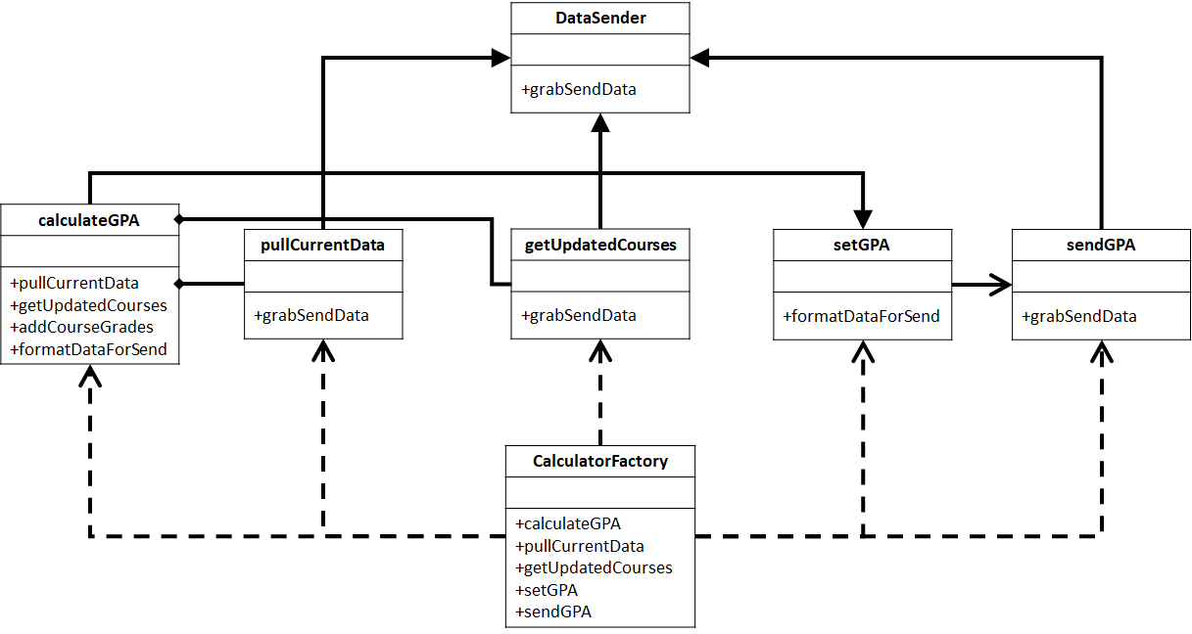
Calculator Class Design

Slide 8
User Command Pattern
UserChange
-Stack<command> changes
+createAccount +changePassword +getGPA +setGoalGPA
<<interface>> Command
+execute()
UserChangeCommand
-user User -changeType ChangeType
-change(User, ChangeType)
Note: Undo action is not necessary. This avoids complications with creating duplicate accounts. Can repeat changePassword and setGoalGPA to overwrite mistakes.

Slide 9
Course Command Pattern
CourseChangeCommand
<<interface>>
Command
-Stack<command> changes
+addCourse
+dropCourse
+undoAddCourse
+undoDropCourse
+execute()
<<interface>>
UndoableCommand
+undo()
CourseChangeCommand
-course Course
-changeType ChangeType
-change(Course, changeType)

Slide 10
Publish-Subscribe
GUI:
Update
GPA
Event
Data Store:
Update Current Data
Update Data Store and Gui with new GPA
Notify GPA change
Calculator:
Send out updated GPA
Calculator:
Calculate new GPA
Calculator:
Request Current Data from Data Store
Data Store:
Send Current data to Calculator
Pull Data from Data Store
Update GPA
Request Data

Slide 11
Patterns Used
Factory
We used this pattern for the calculator since this pattern allows for us to adapt this class to other products
Command
We used this pattern for the User and Course components since they are commanding actions of the data store, you would be commanding account changes and course changes
Publish-Subscribe
We used this pattern for our communications between components since we only have to update/communicate on an event change from the user

